Slide 1
IC HACK 2.0
TITLE: AN INTELLIGENT VEHICLES NETWORKING SYSTEM.
TEAM NAME: VISUAL SPECTACLE
TEAM LEADER NAME : T R ANUREGA
INSTITUTE NAME: Sri Sai Ram Engineering College
TOPIC : Transportation

Slide 2
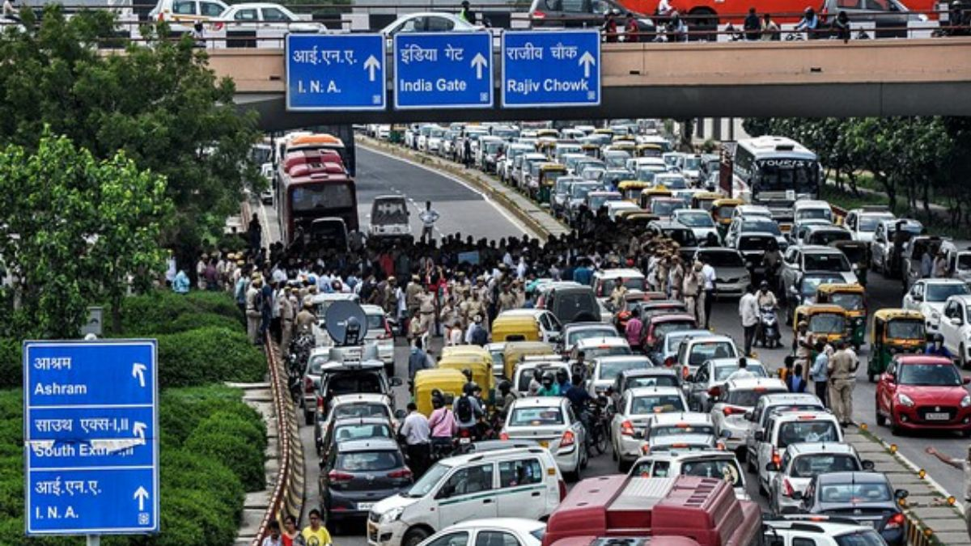
idea/Solution/Prototype:
When ambulances transport patients to hospitals, the route or path they traverse is usually congested, and it is cleared using sirens or manpower. The same goes with fire engine systems. Both of these emergency vehicles frequently fail to arrive at their destinations on time.
Our proposed solution stands out by using “GEOFENCING” technology in order to enhance the efficiency and effectiveness of emergency response systems. Within a city or region, geofencing may be utilized to designate distinct geographic boundaries or zones.
GEO FENCING technology is a location -based networking . When a device enters or exits a designated geographic area, it triggers actions or notifications based on the configured rules.
so our system has a unique approach , the motorist will send a signal to the route he or she is on, which will then send an alert signal within 2 to 3 km of that path. This is done ahead of time to inform that an emergency situation is on its way.
Technology stack here:
SOFTWARE REQUIREMENTS:
1. GEO fencing – to give alert signal
2. Path finding API or Direction API
3. An Application to inform to other vehicles

Slide 3
Idea/Solution/Prototype :
In our app, this method is activated with a single click. When the driver press the button , the alarm signal will rotate to 1 to 2 km and reach other vehicles as a pop-up message, alerting the appropriate people. The message will be transmitted in G-map form, allowing users to readily ascertain the location of emergency vehicles.
We go in one lane, but this GEO FENCING technology informs all lanes within 2 to 3 km of that circle, which is difficult for other lane riders and increases congestion. To avoid this congestion, we use the path finder API or the direction API. This API will identify the specific lane that the emergency vehicles are using.
This strategy informs and intimate to that particular lane and provides a tranquil path for the ambulance. And thus we provide an easier and smarter way of transportation.
We are warning other modes of transportation by utilizing an application ,that will tell them that these emergency vehicles are approaching in a certain lane. Furthermore, we are detecting their respective current location data in real time basis.
We also include a function in our app that pins the location of gas stations and mechanical shops in that area. Our app also displays the path to be followed by the vehicle to the nearest gas station or mechanical shops.
In emergency instances, we provide a booking service as a whole. People in emergency situation can a request for an ambulance or fire engines with just click of a button in our app. Emergency vehicles can reach your place just by accessing the provided location entered in the app
.

Slide 4
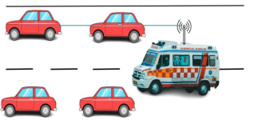
Use Cases:
Dependencies / Show stopper:
This project can be implemented in the busy roads and trafficked areas which connect to hospitals directly via our system
We are incorporating the GEO fencing technology and path finder API
The utilization of our active application will enhance the emergency cases via ambulance to the hospitals without any congestion by traffic and will give a way to smarter India
The whole system should be connected to GPS Application and used by the people .
The other vehicle dashboard or other passengers should be connected to the GPS system.
The entire program is linked to and connected with the G-map API, which is critical for GEO FENCING technology.
THE WORKING TYPE

Slide 5
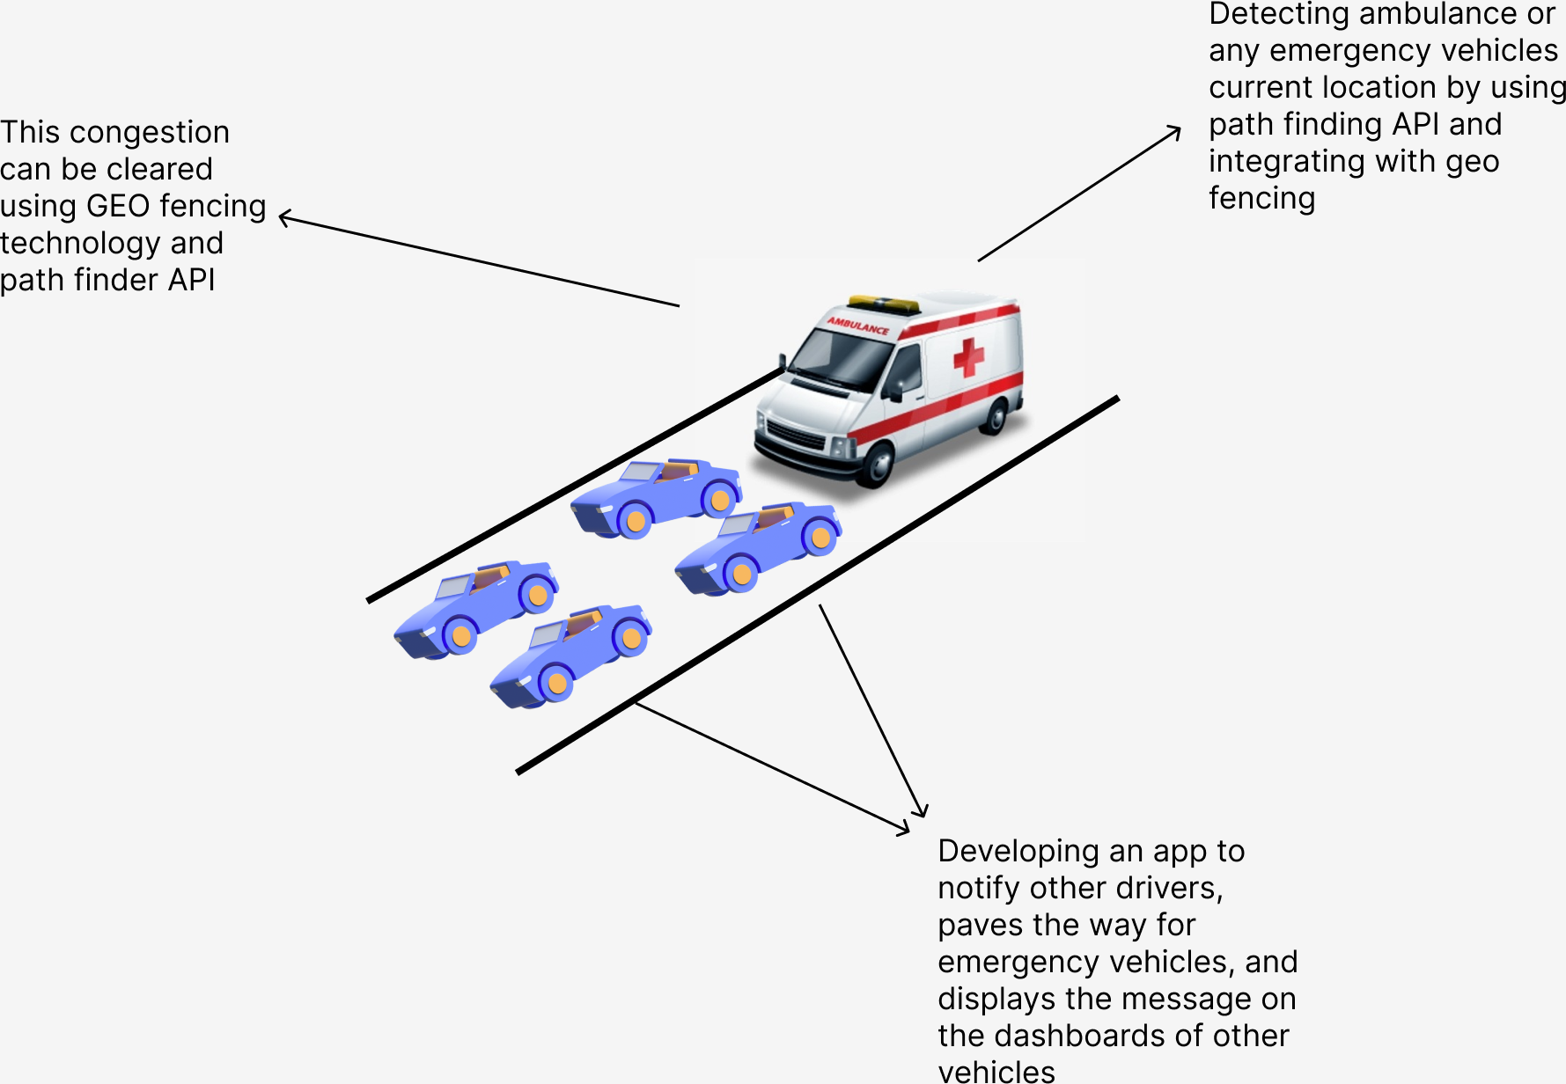
DIAGRAMATIC REPRESENTATION

Slide 6
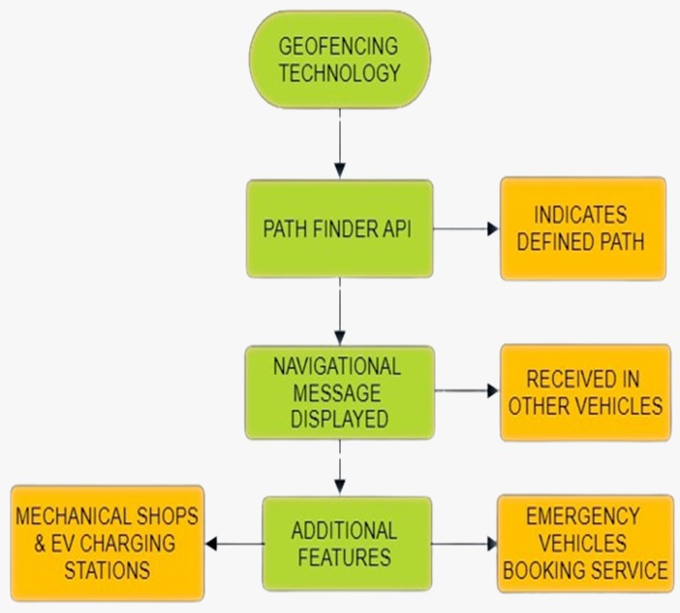
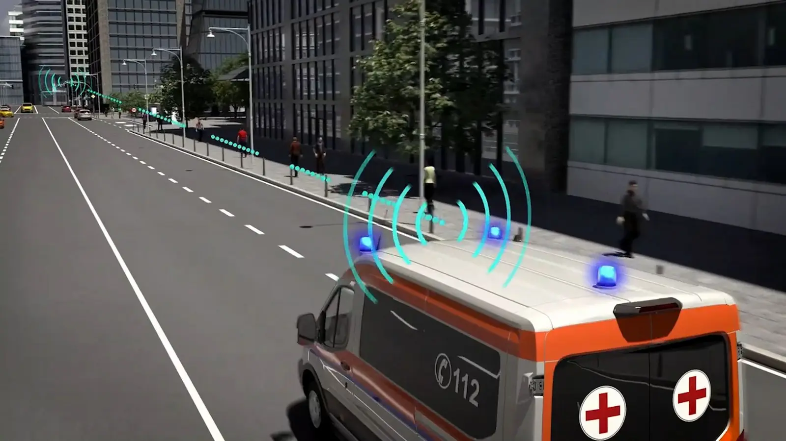
FLOWCHART REPRESENTATION

Slide 7
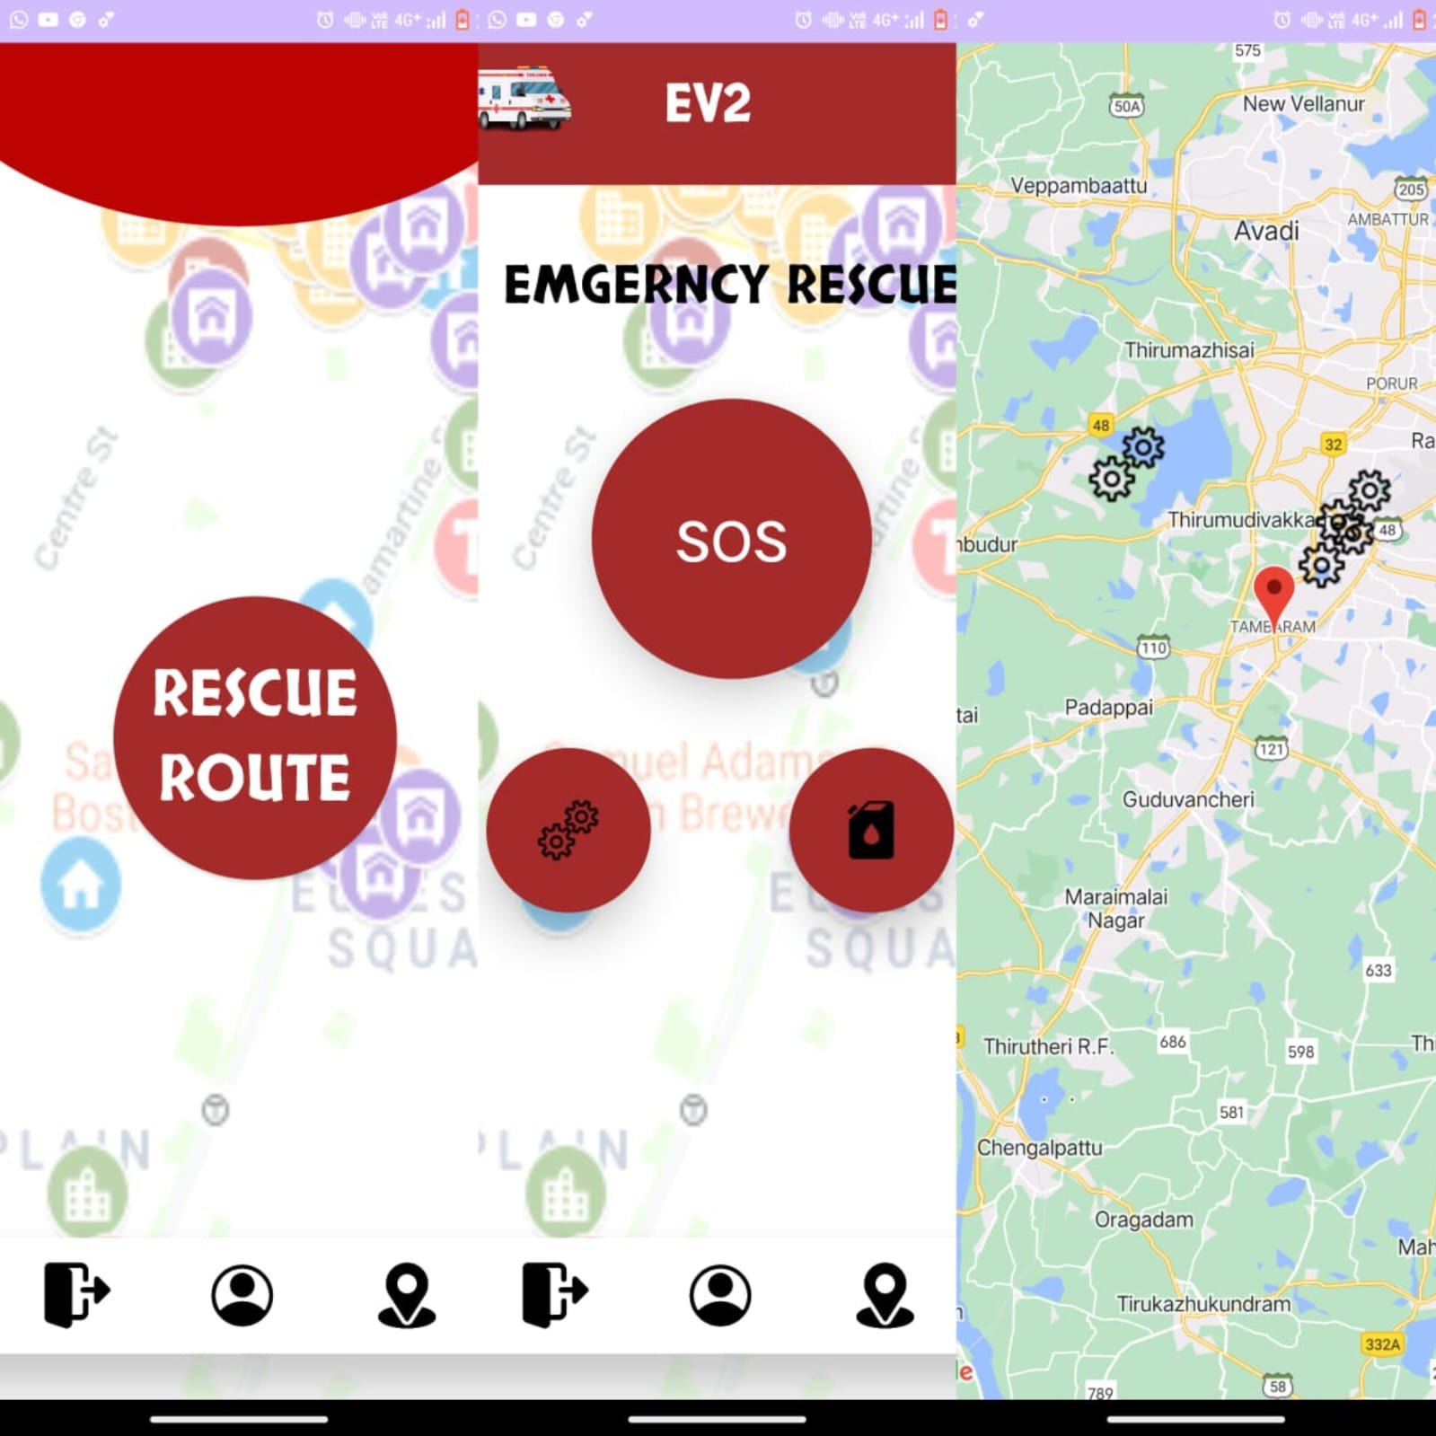

PROTOTYPE
EV2 - EMERGENCY VEHICLE VIGILANT

Slide 8
THANK YOU

